Slide 1
Chapter 3: Processes

Slide 2
Processes
Interprocess Communication (IPC)
Examples of IPC Systems
Communication in Client-Server Systems

Slide 3
Objectives
To describe communication between processes using two models: Shared memory and Message passing

Slide 4
Interprocess Communication
Processes within a system may be independent or cooperating
Cooperating process can affect or be affected by other processes, including sharing data
Reasons for cooperating processes:
  Information sharing
  Computation speedup
  Modularity
  Convenience
Two models of IPC
  Shared memory
  Message passing

Slide 5

Communications Models
(a) Message passing. (b) shared memory.

Slide 6
Quiz
MS-DOS provided no means of concurrent processing. Discuss three major complications that concurrent processing adds to an operating system.

Slide 7
Quiz answer
MS-DOS provided no means of concurrent processing. Discuss three major complications that concurrent processing adds to an operating system.
  A method of time sharing must be implemented to allow each of several processes to have access to the system .
  Processes and system resources must have protections and must be protected from each other. Any given process must be limited in the amount of memory it can use and the operations it can perform on devices like disks.
  Care must be taken in the kernel to prevent deadlocks between processes, so processes aren’t waiting for each other’s allocated resources.

Slide 8
Interprocess Communication – Shared Memory
An area of memory shared among the processes that wish to communicate
The communication is under the control of the users processes not the operating system.
  Resides in the address space of the process creating the shared memory
  Other processes must attach the shared memory to their address space
Major issues is to provide mechanism that will allow the user processes to synchronize their actions when they access shared memory.
Synchronization will be discussed later

Slide 9
Producer-Consumer Problem
Paradigm for cooperating processes, producer process produces information that is consumed by a consumer process
  unbounded-buffer places no practical limit on the size of the buffer
  bounded-buffer assumes that there is a fixed buffer size

Slide 10
Bounded-Buffer – Shared-Memory Solution
Shared data
      #define BUFFER_SIZE 10
      typedef struct {
      . . .
      } item;
      item buffer[BUFFER_SIZE];
      int in = 0;
      int out = 0;
Solution is correct, but can only use BUFFER_SIZE-1 elements

Slide 11
Bounded-Buffer – Producer
item next_produced;
while (true) {
/* produce an item in next_produced */
while (((in + 1) % BUFFER_SIZE) == out)
; /* do nothing */
buffer[in] = next_produced;
in = (in + 1) % BUFFER_SIZE;
}

Slide 12
Bounded Buffer – Consumer
item next_consumed;
while (true) {
while (in == out)
; /* do nothing */
next_consumed = buffer[out];
out = (out + 1) % BUFFER_SIZE;
/* consume the item in next consumed */
}

Slide 13
Interprocess Communication – Message Passing
Mechanism for processes to communicate and to synchronize their actions
Message system – processes communicate with each other without resorting to shared variables
IPC facility provides two operations:
  send(message)
  receive(message)
The message size is either fixed or variable

Slide 14
Message Passing (Cont.)
If processes P and Q wish to communicate, they need to:
  Establish a communication link between them
  Exchange messages via send/receive
Implementation issues:
  How are links established?
  Can a link be associated with more than two processes?
  How many links can there be between every pair of communicating processes?
  What is the capacity of a link?
  Is the size of a message that the link can accommodate fixed or variable?
  Is a link unidirectional or bi-directional?

Slide 15
Message Passing (Cont.)
Implementation of communication link
  Physical:
    Shared memory
    Hardware bus
    Network
  Logical:
    Direct or indirect
    Synchronous or asynchronous
    Automatic or explicit buffering

Slide 16
Direct Communication
Processes must name each other explicitly:
  send (P, message) – send a message to process P
  receive(Q, message) – receive a message from process Q
Properties of communication link
  Links are established automatically
  A link is associated with exactly one pair of communicating processes
  Between each pair there exists exactly one link
  The link may be unidirectional, but is usually bi-directional

Slide 17
Indirect Communication
Messages are sended and received from mailboxes (also referred to as ports)
  Each mailbox has a unique id
  Processes can communicate only if they share a mailbox
Properties of communication link
  Link established only if processes share a common mailbox
  A link may be associated with many processes
  Each pair of processes may share several communication links
  Link may be unidirectional or bi-directional

Slide 18
Indirect Communication
Operations
  create a new mailbox (port)
  send and receive messages through mailbox
  destroy a mailbox
Primitives are defined as:
send(A, message) – send a message to mailbox A
receive(A, message) – receive a message from mailbox A

Slide 19
Indirect Communication
Mailbox sharing
  P₁, P₂, and P₃ share mailbox A
  P₁, sends; P₂ and P₃ receive
  Who gets the message?
Solutions
  Allow a link to be associated with at most two processes
  Allow only one process at a time to execute a receive operation
  Allow the system to select arbitrarily the receiver. Sender is notified who the receiver was.

Slide 20
Synchronization
Message passing may be either blocking or non-blocking
Blocking is considered synchronous
  Blocking send -- the sender is blocked until the message is received
  Blocking receive -- the receiver is blocked until a message is available
Non-blocking is considered asynchronous
  Non-blocking send -- the sender sends the message and continue
  Non-blocking receive -- the receiver receives:
    A valid message, or
    Null message
Different combinations possible
  If both send and receive are blocking, we have a rendezvous

Slide 21
Quiz
What are advantages and disadvantages of a synchronous buffering?

Slide 22
Quiz answer
The advantage of synchronous buffering is that it allows for a rendezvous between the sending process and the receiving process, thereby synchronizing the two processes.
A disadvantage with synchronous communication is that there is only one communication at a time and if a rendezvous is not required, the processes are blocked until the communication is complete and they are unable to perform any other operations

Slide 23
Asynchronous buffering
The advantage of asynchronous buffering is that process flow is not restricted or blocked while waiting for a response.
A disadvantage of asynchronous buffering is that processes need to handle multiple communications.
  This requires additional implementation in order to identify the messages, store, and respond to each message individually.
  The implementation will also need to check if a new message has been received and break from their current process in order to deal with the message.

Slide 24
Synchronization (Cont.)
Producer-consumer becomes trivial
message next_produced;
while (true) {
/* produce an item in next produced */
send(next_produced); }
message next_consumed;
while (true) {
receive(next_consumed);
/* consume the item in next consumed */
}

Slide 25
Buffering
Queue of messages attached to the link; implemented in one of three ways:
  1. Zero capacity – no messages are queued on a link.
  Sender must wait for receiver (rendezvous)
  2. Bounded capacity – finite length of n messages
  Sender must wait if link full
  3. Unbounded capacity – infinite length
  Sender never waits

Slide 26
Quiz
What are advantages and disadvantages of an unbounded capacity buffer?

Slide 27
Quiz answer
Advantages: the operating-system provides the buffers in the form of a queue with indefinite length. This means that any number of messages can wait in the queue, so the sender will never have to block
The disadvantage of automatic buffering is that it involves a more complex system that may be difficult to implement so that it manages memory efficiently. A scheme may reserve a sufficiently large memory space for the messages; however the memory may never fully be used, thereby wasting memory space.

Slide 28
Examples of IPC Systems - POSIX
POSIX Shared Memory
  Process first creates shared memory segment
  id = shmget(IPC_PRIVATE, size, S_IRUSR|S_IWUSR);
  Process wanting access to that shared memory must attach to it
  shared memory = (char *) shmat(id, NULL, 0);
  Now the process could write to the shared memory
  sprintf(shared memory, "Writing to shared memory");
  When done a process can detach the shared memory from its address space
  shmdt(shared memory);
  Remove from the system
  shmct1(segment_id, IPC_RMID,NULL)

Slide 29
IPC POSIX Server
#include <sys/types.h>
#include <sys/ipc.h>
#include <sys/shm.h>
#include <stdio.h>
#define SHMSZ 27
main()
{
char c;
int shmid;
key_t key;
char *shm, *s;
key = 5678; /* arbitrary name */
/* Create the segment */
if ((shmid = shmget(key, SHMSZ,
IPC_CREAT | 0666)) < 0) {
perror("shmget"); exit(1);
}
/* Now we attach the segment to our data space */
if ((shm = shmat(shmid, NULL, 0)) == (char *) -1) {
perror("shmat"); exit(1); }
/* Now put some things into the memory for the * other process to read. */
s = shm;
for (c = 'a'; c <= 'z'; c++) *s++ = c;
*s = NULL;
/* wait until the other process changes the first * character of our memory to '*'*/
while (*shm != '*') /* sleep(1) */;
exit(0);
}

Slide 30
IPC POSIX Client
#include <sys/types.h>
#include <sys/ipc.h>
#include <sys/shm.h>
#include <stdio.h>
#define SHMSZ 27
main()
{
int shmid;
key_t key;
char *shm, *s;
key = 5678; /* chosen in server */
/* Locate the segment */
if ((shmid = shmget(key,SHMSZ, 0666)) < 0) {
perror("shmget"); exit(1);}
/* attach the segment to our data space */
if ((shm = shmat(shmid, NULL, 0)) == (char *) -1)
{
perror("shmat"); exit(1);
}
/* Now read what the server put in the memory. */
for (s = shm; *s != NULL; s++) putchar(*s);
putchar('\n');
/* Change the first character of the segment to '*' */
*shm = '*';
exit(0);
}

Slide 31
Examples of IPC Systems - Mach
Mach communication is message based
  System calls are made by messages
  Each task gets two mailboxes at creation- Kernel and Notify
  Only three system calls needed for message transfer
  msg_send(), msg_receive(), msg_rpc()
  Mailboxes needed for commuincation, created via
  port_allocate()
  Send and receive are flexible, for example four options if mailbox full:
    Wait indefinitely
    Wait at most n milliseconds
    Return immediately
    Temporarily cache a message

Slide 32
Examples of IPC Systems – Windows
Message-passing centric via advanced local procedure call (LPC) facility
  Only works between processes on the same system
  Uses ports (like mailboxes) to establish and maintain communication channels
  Communication works as follows:
    The client opens a handle to the subsystem’s connection port object.
    The client sends a connection request.
    The server creates two private communication ports and returns the handle to one of them to the client.
    The client and server use the corresponding port handle to send messages or callbacks and to listen for replies.

Slide 33

Local Procedure Calls in Windows

Slide 34
Communications in Client-Server Systems
Sockets
Remote Procedure Calls
Pipes
Remote Method Invocation (Java)

Slide 35
Sockets
A socket are used to establish communication between processes running on different computers
message path
socket
socket
Local memory
Local memory

Slide 36
Sockets
A socket is defined as an endpoint for communication
A socket is a virtual connection between two processes running in different computers
Using a socket, two processes can communicate with each other
A socket is identified by an IP address concatenated with a port number
The socket 161.25.19.8:1625 refers to port 1625 on host 161.25.19.8
Communication consists between a pair of sockets

Slide 37

Socket Communication
Concatenation of IP address and port – a number included at start of message packet to differentiate network services on a host
The socket 161.25.19.8:1625 refers to port 1625 on host 161.25.19.8
All ports below 1024 are well known, used for standard services
Special IP address 127.0.0.1 (loopback) to refer to system on which process is running

Slide 38
Sockets
The socket is the major communication tool for the Server/Client Model
The server waits for incoming client requests by listening to a specified port
A socket can be created dynamically
A socket is bidirectional
Machine 1
Machine 2
process1
Socket
Virtual connection
process2
Network
Physical connection

Slide 39
Implementation of sockets
Create a socket
socketid =socket(AF_INET, SOCK_STREAM, DEFAULT_PROTOCOL);
Connecting the socket
status =connect(socketid, (struct sockaddr*)&serverINETaddress, server_len);
Get message information
status = write(socketid, buffer, len);
Receive the acknowledgement
status =read(socketid, buffer, len);
Cut the socket
close(socketid)

Slide 40
Remote Procedure Calls
Remote procedure call (RPC) abstracts procedure calls between processes on networked systems
  Again uses ports for service differentiation
Stubs – client-side proxy for the actual procedure on the server
The client-side stub locates the server and marshalls the parameters
The server-side stub receives this message, unpacks the marshalled parameters, and performs the procedure on the server
On Windows, stub code compile from specification written in Microsoft Interface Definition Language (MIDL)

Slide 41
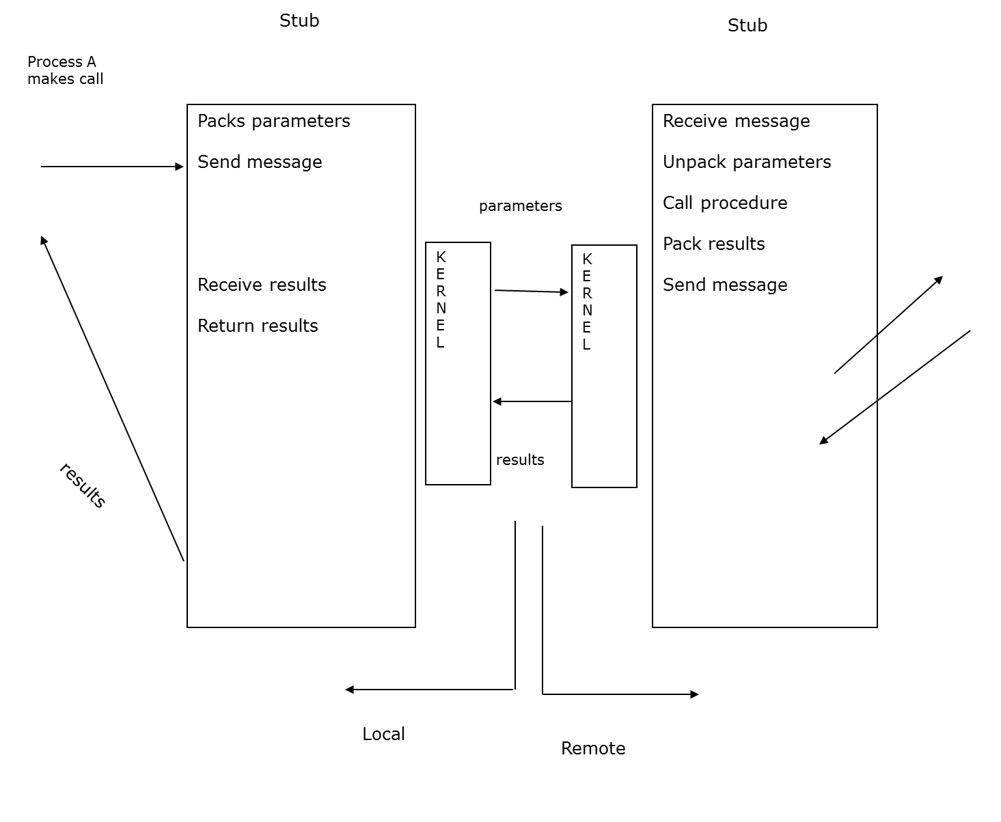
Remote Procedure Calls

Slide 42

Execution of RPC

Slide 43
Pipes
Main communication mechanism for uniprocessor system.
Acts as a conduit allowing two processes to communicate
Asynchronous send and blocking receive (typically)
Send operation implemented as “write”
Receive operation implemented as “read”
Issues
  Is communication unidirectional or bidirectional?
  In the case of two-way communication, is it half or full-duplex?
  Must there exist a relationship (i.e. parent-child) between the communicating processes?
  Can the pipes be used over a network?

Slide 44

Ordinary Pipes
Ordinary Pipes allow communication in standard producer-consumer style
Producer writes to one end (the write-end of the pipe)
Consumer reads from the other end (the read-end of the pipe)
Ordinary pipes are therefore unidirectional
Require parent-child relationship between communicating processes
Windows calls these anonymous pipes
See Unix and Windows code samples in textbook

Slide 45
Named Pipes
Named Pipes are more powerful than ordinary pipes
Communication is bidirectional
No parent-child relationship is necessary between the communicating processes
Several processes can use the named pipe for communication
Provided on both UNIX and Windows systems

Slide 46
Project 1
Header
#include <stdio.h>
#include <sys/types.h>
#include <sys/ipc.h>
#include <sys/shm.h>
#include <stdlib.h>
#include <unistd.h>
#include <errno.h>
/* key number */
#define SHMKEY ((key_t) 1497)

Slide 47
Key
Unix uses this key for identifying shared memory segments.
  A key is a value of type key_t.
  There are three ways to generate a key: ™
    Do it yourself
    ™Use function ftok() ™
    Ask the system to provide a private key.

Slide 48
Key
Do it yourself:
  #define SHMKEY ((key_t) 1497)
Use ftok() to generate one for you:
  key_t = ftok(char *path, int ID);
  path is a path name (e.g., “./”) 
  ID is an integer (e.g., ‘a’)
  Function ftok() returns a key of type key_t: Key = ftok(“./”, ‘x’);
Keys are global entities. If other processes know your key, they can access your shared memory.
Ask the system to provide a private key using IPC_PRIVATE

Slide 49
Project 1
shared memory
  typedef struct
  {
  int value;
  } shared_mem;
  shared_mem *total;
process1 increases the value of shared variable "total“ * by some number
process2
process3
process4

Slide 50
Project 1
Main function
  int shmid, pid1,pid2, pid3,pid4, ID,status;
  char *shmadd;
  shmadd = (char *) 0;
/* Create and connect to a shared memory segment*/
  if ((shmid = shmget (SHMKEY, sizeof(int), IPC_CREAT | 0666)) < 0)
  {
  perror ("shmget");
  exit (1); }
  if ((total = (shared_mem *) shmat (shmid, shmadd, 0)) == (shared_mem *) -1) {
  perror ("shmat");
  exit (0);
Use shmget() to request a shared memory:

Slide 51
Project 1
Initialize shared memory to 0
  total->value = 0;
Create processes
  if ((pid1 = fork()) == 0)
  process1();
  Create additional processes

Slide 52
Project 1
Parent wait for child processes to finish and print ID of each child. Three ways:
  wait(&status)
  wait(NULL)
  waitpid(pid1, NULL, 0);
  printf("Child %d pid has just exited.\n", pid1);

Slide 53
Project 1
To detach a shared memory, use shmdt(total);
  total is the pointer returned by shmat()
  if (shmdt(total) == -1) {
  perror ("shmdt");
  exit (-1);
  }
To remove a shared memory, use shmctl(shmid, IPC_RMID, NULL);
  shmid is the shared memory ID returned by shmget().
After a shared memory is removed, it no longer exists.

Slide 54
Notes
If you did not remove your shared memory segments (e.g., program crashes before the execution of shmctl()), they will be in the system forever. This will degrade the system performance. ‰
Use the ipcs command to check if you have shared memory segments left in the system. ‰
Use the ipcrm command to remove your shared memory segments.

Slide 55
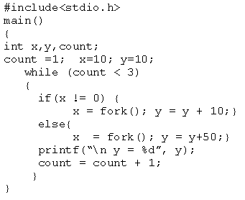
Example

Slide 56
End of Chapter 3

